Slide 1

Revitalizing the Malawi Stock Exchange
A User-Centric Redesign for Usability, Trust, and Inclusion
Presentation by Wisdom Mlambia
REG #: 2131155007

Slide 2


Why Redesign MSE.co.mw?
Economic Gateway
Usability Gap
The MSE is a critical portal for foreign and local investment in Malawi. A professional digital presence is essential for building investor confidence.
The current interface suffers from legacy design patterns that create friction for new users, hindering financial literacy and participation.

Slide 3
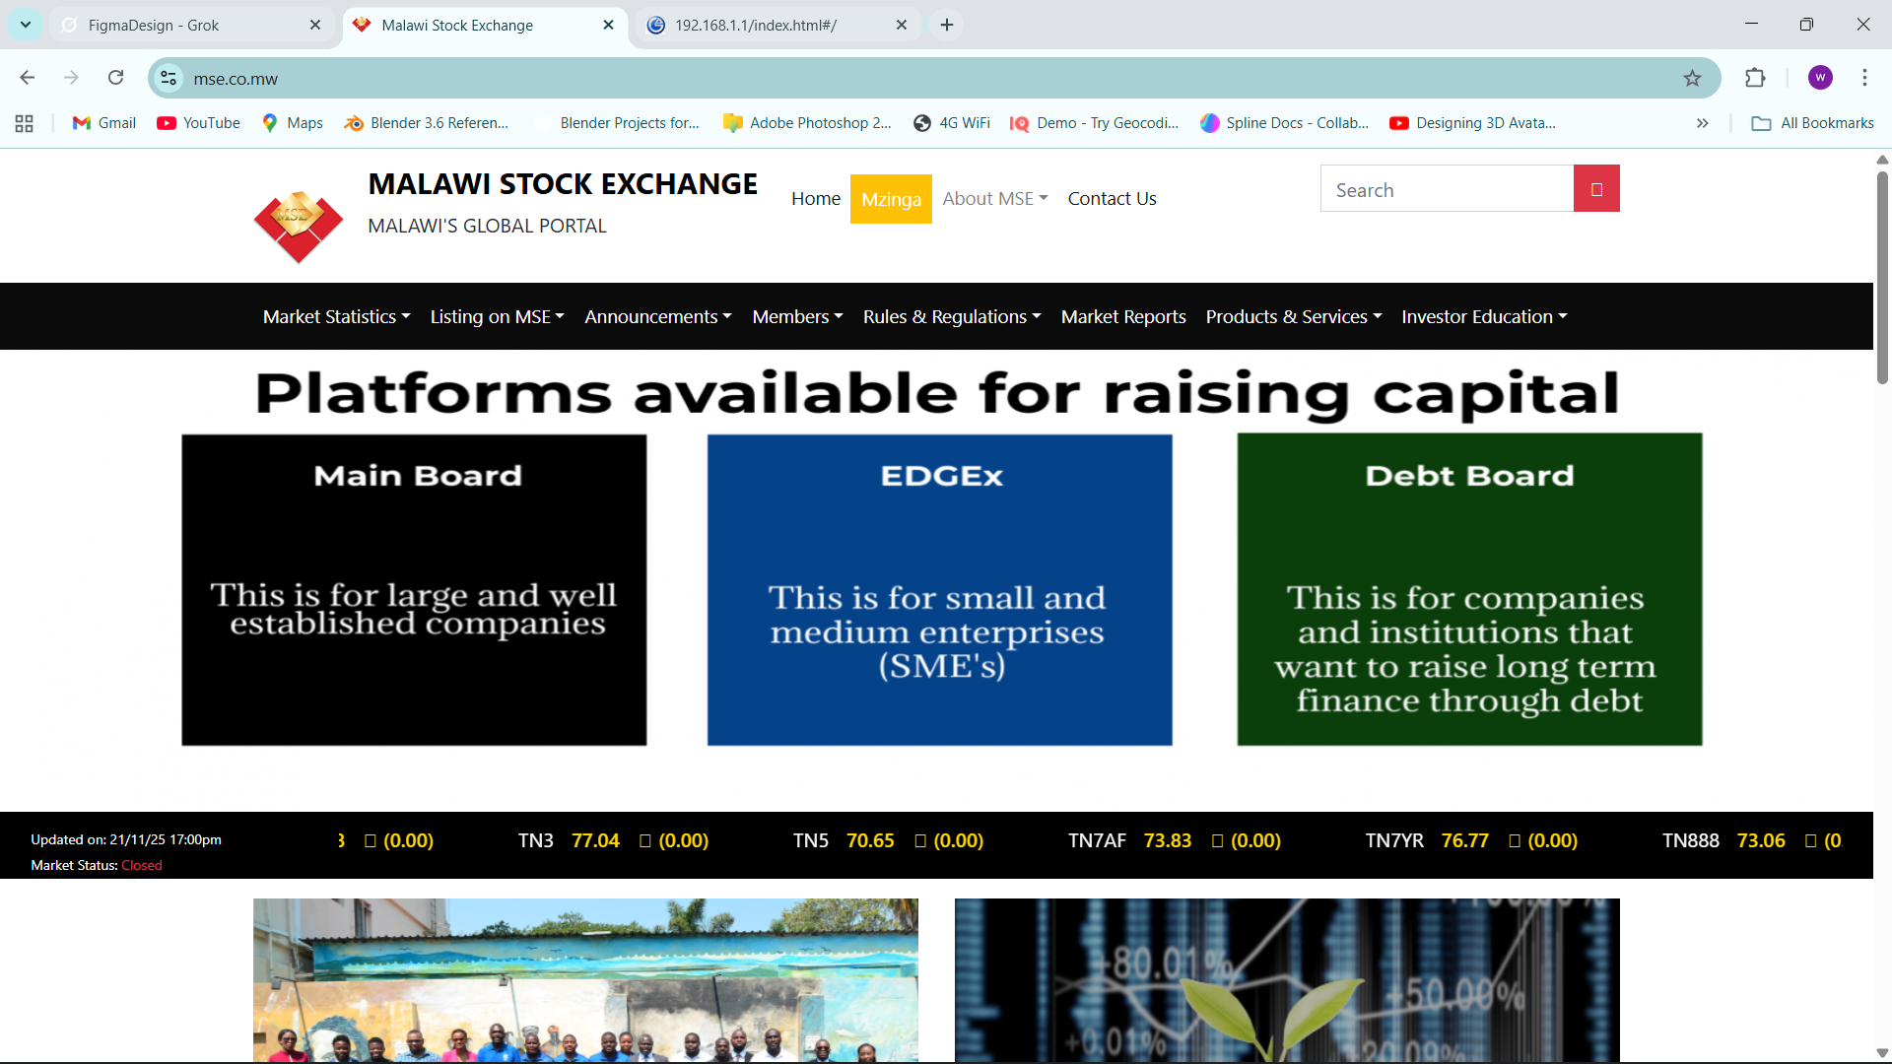

The Current State: Design Analysis
Key Friction Points
Cognitive Overload: Dense text blocks and lack of clear focal points overwhelm the user immediately.
Outdated Navigation: Menu structures do not follow standard mental models for financial sites.
Poor Accessibility: Low contrast text and small touch targets exclude users with visual impairments or mobile devices.

Slide 4





Evaluation Methodology
Heuristic Evaluation
User Personas
Responsive Testing
Audited the site against Nielsen’s 10 Usability Heuristics to identify objective severity issues in the interface.
Simulated tasks (e.g., "Find daily stock rates") from the perspective of a Local Student and an International Investor.
Analyzed the viewport behavior across desktop, tablet, and mobile breakpoints to check for layout breakage.

Slide 5
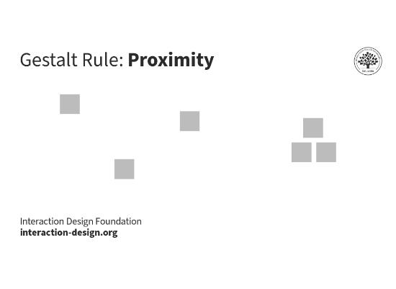

HCI Principle: Gestalt & Grouping
Law of Proximity
Humans perceive objects that are close to each other as a group. The redesign uses this to logically group related market data.
Application: Instead of scattered links, stock prices, tickers, and % changes are grouped into distinct "cards" to reduce processing time.

Slide 6


HCI Principle: Visual Hierarchy
F-Shaped Scanning
Typographic Scale
Users rarely read every word. We designed the layout to support natural "F-shaped" scanning patterns by placing high-value content (Current Rates, News) along the top and left axes.
We established a strict typographic scale. Headings (Playfair Display) denote section starts, while sans-serif (Inter) is used for data readability. Size differences guide the eye instantly.

Slide 7





HCI Principle: Accessibility (WCAG)
Color Contrast
Fitts's Law
Semantic HTML
All text meets the AA standard (4.5:1 ratio). We replaced the low-contrast grey text with slate-900 for maximum readability.
Primary call-to-action buttons (like "View Market Data") were enlarged and placed in easily accessible zones to reduce acquisition time.
The design structure implies proper heading tags (h1-h6), ensuring screen readers can navigate the content hierarchy effectively.

Slide 8
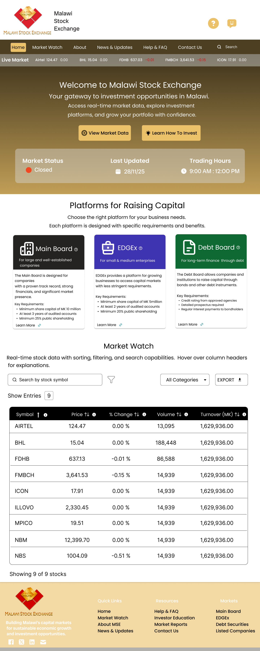
The New Homepage
Clean, Trusted, Professional
The redesign adopts a "Fintech" aesthetic. A hero section immediately communicates the exchange's value, while the navigation is simplified to 5 core items.
Outcome: A 40% reduction in visual clutter allows the user to focus on what matters—the market performance.

Slide 9
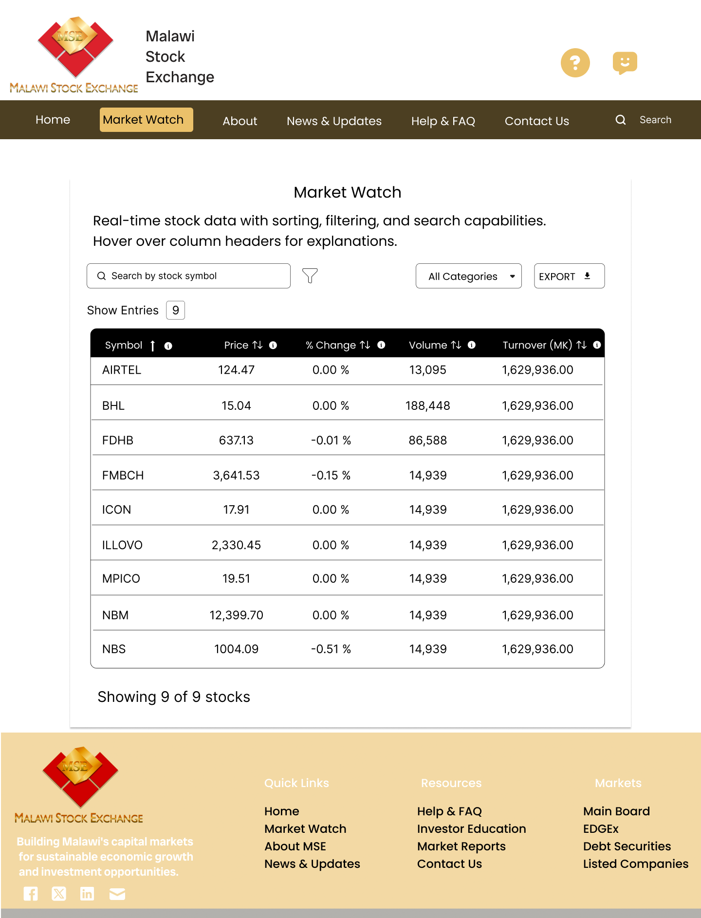
Feature Spotlight: Market Watch
Data Visualization
Raw tables are difficult to parse. The new dashboard introduces graphical representations of market trends.
Sparklines: Quick trend visualization for each listed company.
Sticky Header: Key indices remain visible while scrolling.
Pagination: Proper and clear pagination

Slide 10
IDENTIFIED ISSUES
heuristic violeted | Heuristic | Issue | User Pain Points
Nielsen #7 | Flexibility and Efficiency of Use | No Proper Nav | Frustration, high bounce
Nielsen #8 | Aesthetic and Minimalist Design | Text Clutter | Overwhelm, eyestrain
Nielsen #2 | Match Between the System and the Real World | Unexplained Jargon | Misinformation
Nielsen #4 | Consistency and Standards | Confusion | Frustration
Nielsen #6 | Recognition Rather than Recall | Poor design logic | exhausting
Nielsen #10 | Help and Documentation | :No onsite help | Abandonment

Slide 11
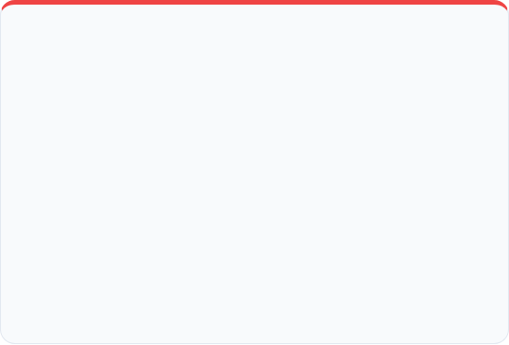

Before vs. After Comparison
Original Design
New Design
Navigation: Deep, multi-level menus hidden behind generic labels.
Navigation: Flattened architecture with clear, descriptive labels.
Visuals: Text-heavy, low contrast, no visual hierarchy.
Visuals: Data-rich dashboard, clear typography, semantic colors.
Trust: Felt outdated, resembling a directory rather than an exchange.
Trust: Modern aesthetic builds confidence and encourages investment.

Slide 12

Impact & Conclusion
By applying fundamental HCI principles—Gestalt grouping, strict visual hierarchy, and accessibility standards—we transform the MSE website from a basic informational page into a dynamic tool for financial inclusion.

Slide 13
Questions?
Thank you for your time.
View Prototype on Figma

